Slide 1
Recommendation Systems
By Anmol Bansal
Project Teacher -
Dr. Sumedha Arora

Slide 2
Importance:-
Recommender system has the ability to predict whether a particular user would prefer an item or not based on the user's profile.
Recommender systems are beneficial to both service providers and users.
They reduce transaction costs of finding and selecting items in an online shopping environment.
Every big and small company uses this to improve there services and provide a comfortable experience for the user.
Recommendations can be in any aspect of day to day’s life, therefore the service providers invests heavily in these systems.

Slide 3
Methodology:-
Get the User Data.
Clean it and check for any null values. Calculate mean and quantile.
Work out a Formula.
Formula should be rational and universal. It should be based on UX.
Generally a cosine similarity matrix is used.
Test it on Users
Again get data from user and improve model to handle big dataset easily.
Build A Model

Slide 4
Insight into Cosine Similarity Matrix
It is a mathematical way to work out how “similar” the documents are.
The most basic way to find similarity between documents is to count the common words and based on that state assumptions.
But this basic approach has a flaw. What if the no. of documents are increased? This fails right away as no. of common words will increase, even if the documents are talking about different topics.
Cosine similarity matrix eliminates this and hence a powerful mathematics.
Mathematically, it measures the cosine of the angle between two vectors projected in a multi-dimensional space. The two vectors here are arrays containing the word counts of two documents.

Slide 5
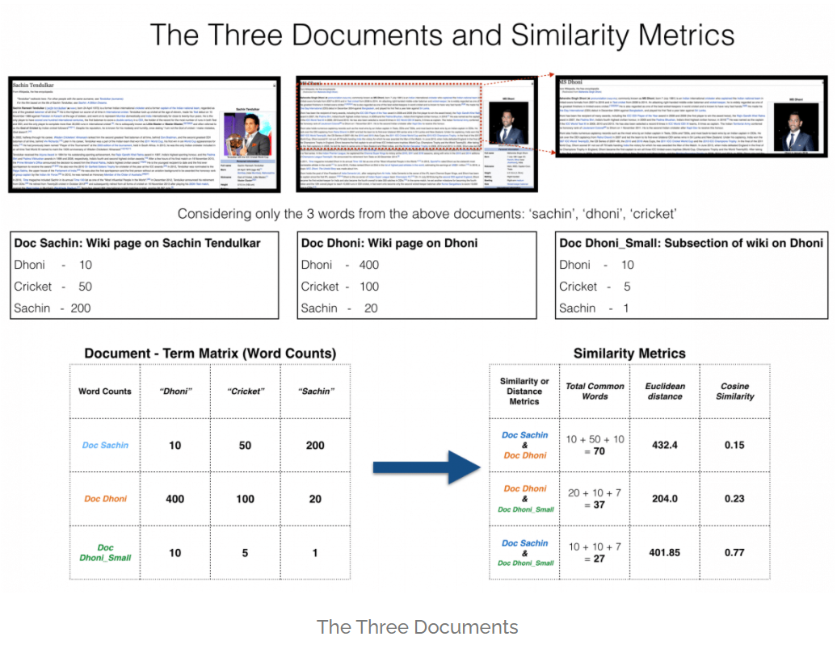

Slide 6
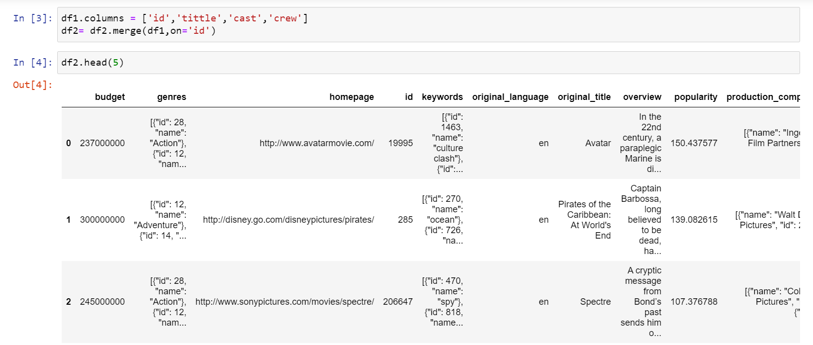
Code Snippets:-
Looking at the raw data.
Now cleaning it and shaping it as per needs.

Slide 7
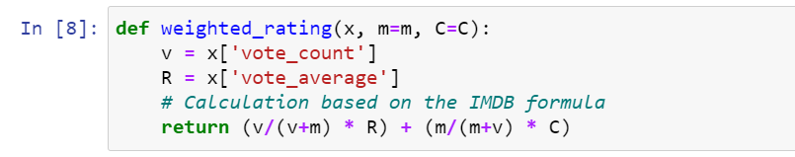
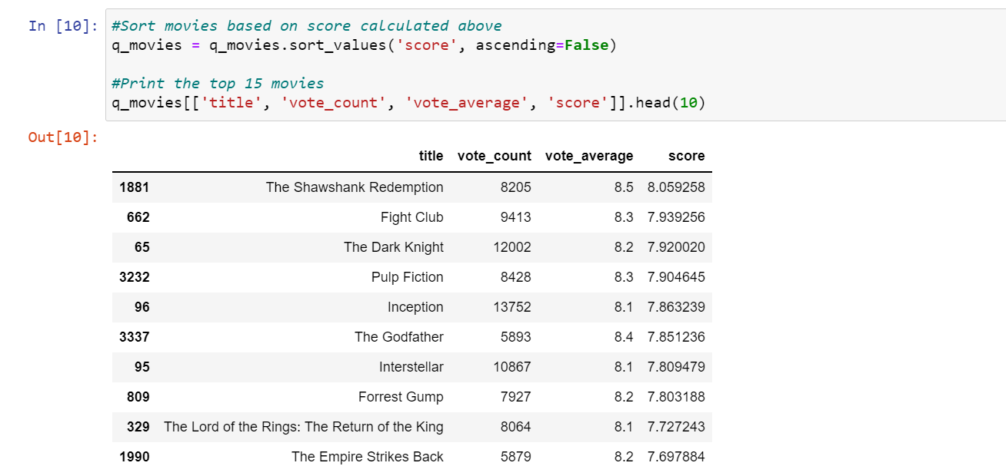
2. Cleaned data after devising the formula.

Slide 8
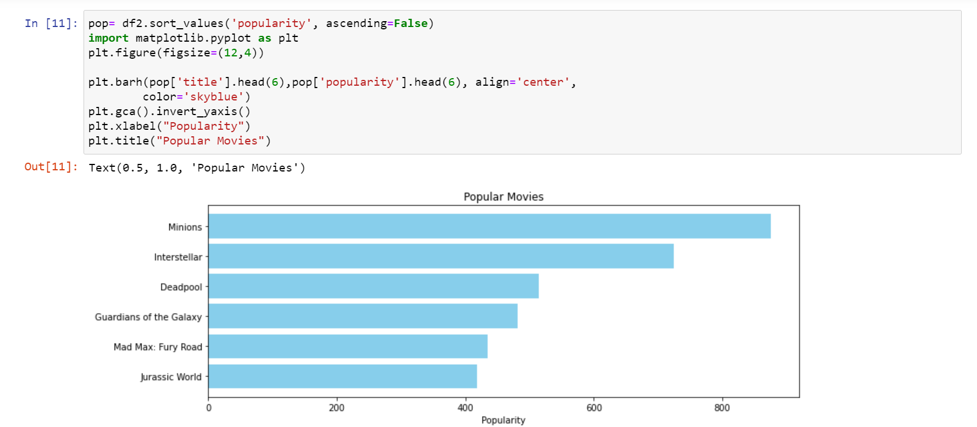
3. Having a look at the data with graphs for more understanding.

Slide 9
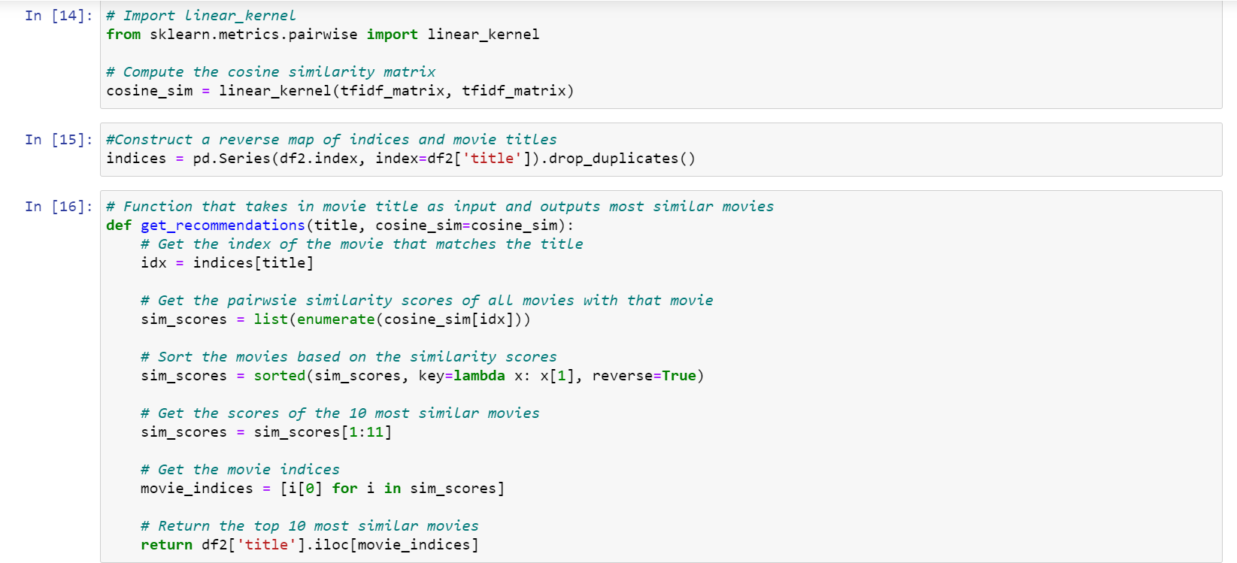
4. Building a Model

Slide 10
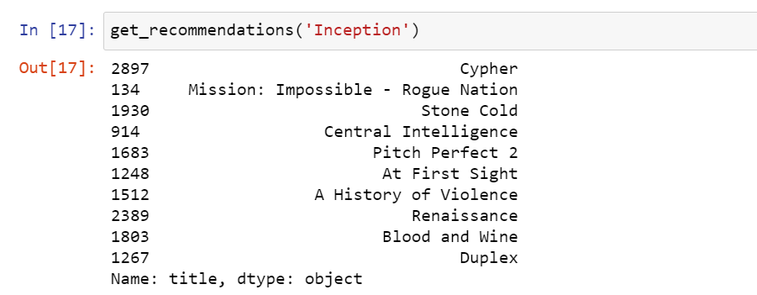
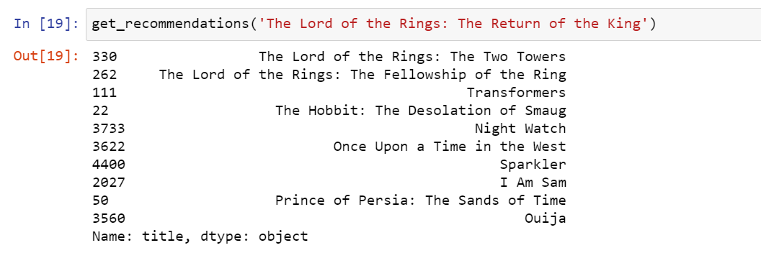
5. Results

Slide 11
Future Scope:-
It is already in use.
This is actually a big thing for companies like Google and Netflix. Because these are well known for giving their user the best experience.
Even now the data from 90’s and 80’s are being pulled out and studied to make user experience better for every age group be it adults, senior citizens or children.
This notebook covers a very basic way to explore recommendation systems but now we are having neural networks a.k.a. deep learning.
These actually work on training machine to impute results and assumptions on there own. All thanks to the idea first ever proposed by Warren McCullough and Walter Pitts in 1944.

Slide 12
Thank you

